Slide 1

DISCLAIMER
The information in this presentation is provided to you by PT. AXAR Technology Raya, solely for informational purposes and does not constitute an offer to buy, sell or issue, or a solicitation of an offer to sell, buy or acquire any securities of the Company in any jurisdiction or an inducement to enter into investment activity, nor may it or any part of it form the basis of or be relied on in connection with any contract or commitment whatsoever. No representations or warranties, express or implied, are made by the Company, any underwriters, any of their respective affiliates, directors, officers, employees, advisors or representatives with respect to, and no reliance should be placed, on the accuracy, fairness or completeness of the information presented or contained in this presentation. By viewing this presentation, you agree that none of the Company, any underwriters, nor any of their respective affiliates, directors, officers, employees, advisors or representatives accepts any responsibility or liability whatsoever for any loss howsoever arising from any information presented or contained in or derived from or omitted from this presentation. The information presented or contained in this presentation was obtained from various sources, including certain third parties, and has not been independently verified, and its accuracy is not guaranteed.
This presentation does not contain all relevant information relating to the Company or its securities, particularly with respect to the risks and special considerations involved with an investment in the securities of the Company. These materials are not an offer of securities for sale. Any public offering will be made by means of a prospectus that may be obtained from the issuer and that will contain detailed information about the company and management, as well as financial statements. This presentation speaks as of its date and the information presented or contained in this presentation is subject to change without notice or update.
This presentation contains statements that constitute forward-looking statements. These statements include descriptions regarding the intent, belief or current expectations of the Company or its officers about the future. These statements can be recognized by the use of words such as “expects,” “plans,” “will,” “estimates,” “projects,” “intends,” or words of similar meaning. Such forward-looking statements are not guarantees of future performance and involve risks and uncertainties, and actual results may differ from those in the forward-looking statements as a result of various factors and assumptions, many of which are beyond the Company’s control. The Company or any of its affiliates, advisors, representatives or underwriters has no obligation and does not undertake to revise forward-looking statements to reflect future events or circumstances.
THE INFORMATION CONTAINED IN THIS DOCUMENT IS HIGHLY CONFIDENTIAL AND MAY NOT BE FORWARDED, PUBLISHED OR DISTRIBUTED, DIRECTLY OR INDIRECTLY, TO ANY OTHER PERSON (WHETHER WITHIN OR OUTSIDE YOUR ORGANIZATION/FIRM) FOR ANY PURPOSE AND MAY NOT BE REPRODUCED IN ANY MANNER WHATSOEVER. ANY FORWARDING, PUBLICATION, DISTRIBUTION OR REPRODUCTION OF THIS DOCUMENT IN WHOLE OR IN PART IS UNAUTHORIZED.
MOBILE
DEVELOPMENT
DAY 1

Slide 2
OBJECTIVES
Stateless dan statefull
Navigator
Notes:
Save Time....:
The Platform will house/aggregate thousands of DIRECT SUPPLIERS. Buyer members are now abled to easily Pick whats best suitable for them.
Discover...:
Suppliers need to be a registered and verified members. There will be features such as ratings and certifications to boost further.
Grow Business:
Members akan di-empowered dengan sebuah tool digital yang yang tadinya menyerang industri, malah justru membuat mereka bisa menjadi lebih kompetitif di era digital.

Slide 3
Stateless widget
Stateless widget adalah widget yang hanya bertugas untuk menampilkan sesuatu secara statis. Tanpa melakukan tracking perubahan data dari waktu ke waktu.
Pada pertemuan sebelumnya kita telah membuat yang pattern widget yang berulang-ulang dalam bentuk dan kondisi yang sama. Tentunya hal tersebut tidak efisien, kita dapat menggunakan stateless widget untuk mengatasi hal tersebut.
Notes:
Save Time....:
The Platform will house/aggregate thousands of DIRECT SUPPLIERS. Buyer members are now abled to easily Pick whats best suitable for them.
Discover...:
Suppliers need to be a registered and verified members. There will be features such as ratings and certifications to boost further.
Grow Business:
Members akan di-empowered dengan sebuah tool digital yang yang tadinya menyerang industri, malah justru membuat mereka bisa menjadi lebih kompetitif di era digital.

Slide 4
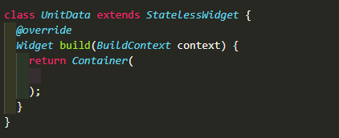
Stateless widget
Step 1 : Buatlah sebuah kelas stateless dengan nama yang sesuai
Step 2 : Buat attribut kelas,
Step 3 : Buat pattern dari kumpulan widget yang kita gunakan
Step 1 :
Notes:
Save Time....:
The Platform will house/aggregate thousands of DIRECT SUPPLIERS. Buyer members are now abled to easily Pick whats best suitable for them.
Discover...:
Suppliers need to be a registered and verified members. There will be features such as ratings and certifications to boost further.
Grow Business:
Members akan di-empowered dengan sebuah tool digital yang yang tadinya menyerang industri, malah justru membuat mereka bisa menjadi lebih kompetitif di era digital.

Slide 5
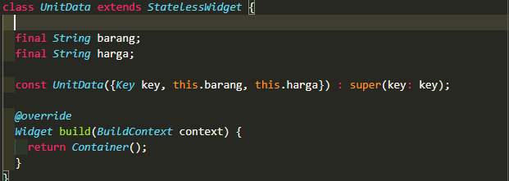
Stateless widget
Step 2 :
ada attribut yang dibutuhkan pattern widget yang akan kita buat adalah barang dan harga dalam bentuk string.
Silahkan buat attribut dan constructor pada kelas tersebut.
Notes:
Save Time....:
The Platform will house/aggregate thousands of DIRECT SUPPLIERS. Buyer members are now abled to easily Pick whats best suitable for them.
Discover...:
Suppliers need to be a registered and verified members. There will be features such as ratings and certifications to boost further.
Grow Business:
Members akan di-empowered dengan sebuah tool digital yang yang tadinya menyerang industri, malah justru membuat mereka bisa menjadi lebih kompetitif di era digital.

Slide 6
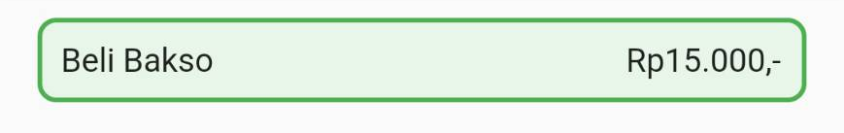
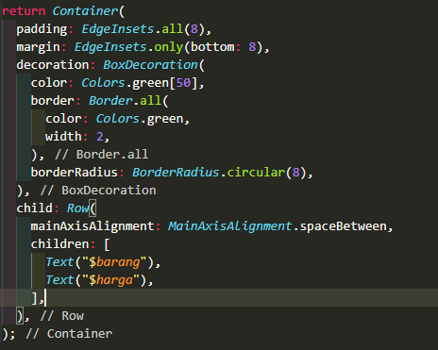
Stateless widget
Step 3 :
Kita kan membuat pattern widget sesuai gambar dibawah ini, dimana bakso adalah representasi dari attribut barang dan Rp15.000,- adalah representasi dari attribut harga
Notes:
Save Time....:
The Platform will house/aggregate thousands of DIRECT SUPPLIERS. Buyer members are now abled to easily Pick whats best suitable for them.
Discover...:
Suppliers need to be a registered and verified members. There will be features such as ratings and certifications to boost further.
Grow Business:
Members akan di-empowered dengan sebuah tool digital yang yang tadinya menyerang industri, malah justru membuat mereka bisa menjadi lebih kompetitif di era digital.

Slide 7
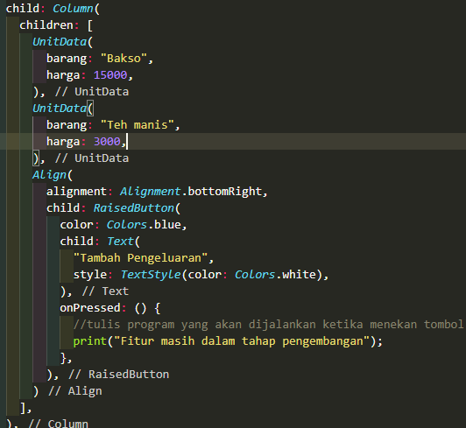
Stateless widget
Dengan membuat pattern widget tersebut, kita dapat widget buatan kita hanya dengan memanggil kelasnya dan memberikan value dari attribut nya.
berikut adalah adalah impelementasi pada bagian column kodingan.
Notes:
Save Time....:
The Platform will house/aggregate thousands of DIRECT SUPPLIERS. Buyer members are now abled to easily Pick whats best suitable for them.
Discover...:
Suppliers need to be a registered and verified members. There will be features such as ratings and certifications to boost further.
Grow Business:
Members akan di-empowered dengan sebuah tool digital yang yang tadinya menyerang industri, malah justru membuat mereka bisa menjadi lebih kompetitif di era digital.

Slide 8
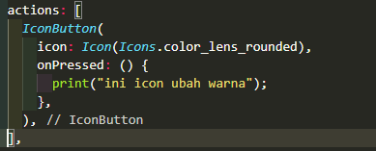
Statefull widget
Stateful widget merupakan widget yang sifatnya dinamis, sehingga widget ini dapat diperbaharui kapanpun dibutuhkan berdasarkan user actions atau ketika terjadinya perubahan data.
berikut ini adalah contoh implementasinya :
Pada pertemuan sebelumnya kita telah membuat 2 IconButton pada pojok kanan atas halaman, Ubahlah action pada appBar tersebut sebagai berikut :
Notes:
Save Time....:
The Platform will house/aggregate thousands of DIRECT SUPPLIERS. Buyer members are now abled to easily Pick whats best suitable for them.
Discover...:
Suppliers need to be a registered and verified members. There will be features such as ratings and certifications to boost further.
Grow Business:
Members akan di-empowered dengan sebuah tool digital yang yang tadinya menyerang industri, malah justru membuat mereka bisa menjadi lebih kompetitif di era digital.

Slide 9

Statefull widget
Icon tersebut berfungsi untuk mengubah warna biru pada layar menjadi warna hijau, dan sebaliknya jika ditekan lagi.
Adapun tahapannya adalah sebagai berikut :
Step 1 : Ubah kelas homepage stateless menjadi statefull
Step 2 : Buatlah sebuah variable untuk menampung value Color
Step 3 : implementasikan variable tersebut pada seluruh penggunaann warna. Pada step ini, kita juga harus menambahkan attribut warna pada kelas stateless yang sebelumnya telah dibuat agar dapat menyesuaikan warna.
Notes:
Save Time....:
The Platform will house/aggregate thousands of DIRECT SUPPLIERS. Buyer members are now abled to easily Pick whats best suitable for them.
Discover...:
Suppliers need to be a registered and verified members. There will be features such as ratings and certifications to boost further.
Grow Business:
Members akan di-empowered dengan sebuah tool digital yang yang tadinya menyerang industri, malah justru membuat mereka bisa menjadi lebih kompetitif di era digital.

Slide 10
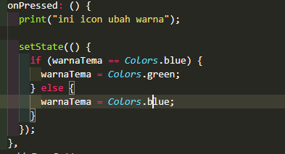
Statelefull widget
Step 4 : gunakan prosedur untuk mengubah value pada variable warna.
Tambahkan program diatas pada block onPresss di RaisedButton.
Notes:
Save Time....:
The Platform will house/aggregate thousands of DIRECT SUPPLIERS. Buyer members are now abled to easily Pick whats best suitable for them.
Discover...:
Suppliers need to be a registered and verified members. There will be features such as ratings and certifications to boost further.
Grow Business:
Members akan di-empowered dengan sebuah tool digital yang yang tadinya menyerang industri, malah justru membuat mereka bisa menjadi lebih kompetitif di era digital.

Slide 11
Navigator
Navigasi merupakan kunci dari aplikasi berbasis mobile dimana user dapat berpindah antar halaman, misalanya user membuka halaman utama dan halaman detail, flutter menyediakan kelas Navigator untuk membantu kita melakukan navigasi pada aplikasi.
Notes:
Save Time....:
The Platform will house/aggregate thousands of DIRECT SUPPLIERS. Buyer members are now abled to easily Pick whats best suitable for them.
Discover...:
Suppliers need to be a registered and verified members. There will be features such as ratings and certifications to boost further.
Grow Business:
Members akan di-empowered dengan sebuah tool digital yang yang tadinya menyerang industri, malah justru membuat mereka bisa menjadi lebih kompetitif di era digital.

Slide 12

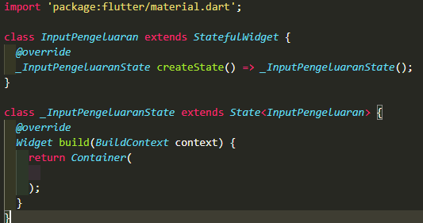
Stateless widget
Pada praktik kali ini, silahkan buat halaman baru yang dapat menerima input barang dan harga untuk ditatat.
Step 1.
Silahkan buat file dengan extensi dart pada folder lib.
Step 2.
Silahkan buat sebuat class statefull dengan nama yang sesuai
Notes:
Save Time....:
The Platform will house/aggregate thousands of DIRECT SUPPLIERS. Buyer members are now abled to easily Pick whats best suitable for them.
Discover...:
Suppliers need to be a registered and verified members. There will be features such as ratings and certifications to boost further.
Grow Business:
Members akan di-empowered dengan sebuah tool digital yang yang tadinya menyerang industri, malah justru membuat mereka bisa menjadi lebih kompetitif di era digital.

Slide 13
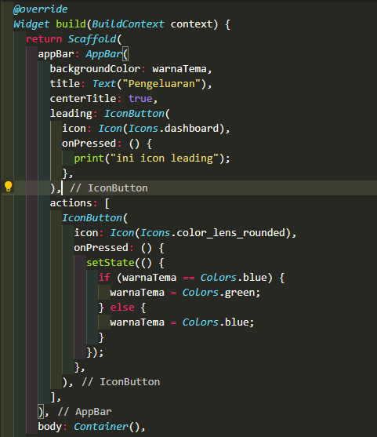
Stateless widget
Step 3.
Silahkan buat appBar dan body dengan container kosong.
Notes:
Save Time....:
The Platform will house/aggregate thousands of DIRECT SUPPLIERS. Buyer members are now abled to easily Pick whats best suitable for them.
Discover...:
Suppliers need to be a registered and verified members. There will be features such as ratings and certifications to boost further.
Grow Business:
Members akan di-empowered dengan sebuah tool digital yang yang tadinya menyerang industri, malah justru membuat mereka bisa menjadi lebih kompetitif di era digital.

Slide 14
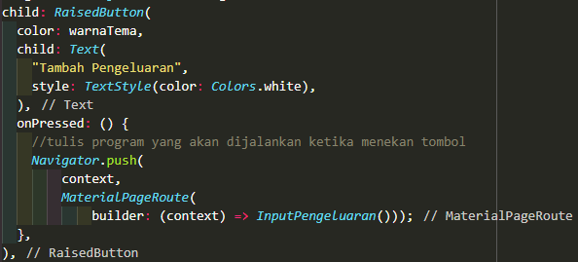
Stateless widget
Step 4.
Tambahkan kodingan navigasi pada tombol “Tambah Pengeluaran”, kemudian tekan r pada terminal untuk melakukan hold reload. Dan selanjutnya tekan tombol tambah pengeluaran untuk berpindah halaman.
Notes:
Save Time....:
The Platform will house/aggregate thousands of DIRECT SUPPLIERS. Buyer members are now abled to easily Pick whats best suitable for them.
Discover...:
Suppliers need to be a registered and verified members. There will be features such as ratings and certifications to boost further.
Grow Business:
Members akan di-empowered dengan sebuah tool digital yang yang tadinya menyerang industri, malah justru membuat mereka bisa menjadi lebih kompetitif di era digital.

Slide 15
Stateless widget
Step 5.
Buat 2 TextField widget untuk barang dan harga,
buat 1 Tombol untuk menyimpang catatan tersebut.
Untuk kode lengkapnya silahkan lihat pada link berikut :
[LINK]
Notes:
Save Time....:
The Platform will house/aggregate thousands of DIRECT SUPPLIERS. Buyer members are now abled to easily Pick whats best suitable for them.
Discover...:
Suppliers need to be a registered and verified members. There will be features such as ratings and certifications to boost further.
Grow Business:
Members akan di-empowered dengan sebuah tool digital yang yang tadinya menyerang industri, malah justru membuat mereka bisa menjadi lebih kompetitif di era digital.

Slide 16
DISCLAIMER
The information in this presentation is provided to you by PT. AXAR Technology Raya, solely for informational purposes and does not constitute an offer to buy, sell or issue, or a solicitation of an offer to sell, buy or acquire any securities of the Company in any jurisdiction or an inducement to enter into investment activity, nor may it or any part of it form the basis of or be relied on in connection with any contract or commitment whatsoever. No representations or warranties, express or implied, are made by the Company, any underwriters, any of their respective affiliates, directors, officers, employees, advisors or representatives with respect to, and no reliance should be placed, on the accuracy, fairness or completeness of the information presented or contained in this presentation. By viewing this presentation, you agree that none of the Company, any underwriters, nor any of their respective affiliates, directors, officers, employees, advisors or representatives accepts any responsibility or liability whatsoever for any loss howsoever arising from any information presented or contained in or derived from or omitted from this presentation. The information presented or contained in this presentation was obtained from various sources, including certain third parties, and has not been independently verified, and its accuracy is not guaranteed.
This presentation does not contain all relevant information relating to the Company or its securities, particularly with respect to the risks and special considerations involved with an investment in the securities of the Company. These materials are not an offer of securities for sale. Any public offering will be made by means of a prospectus that may be obtained from the issuer and that will contain detailed information about the company and management, as well as financial statements. This presentation speaks as of its date and the information presented or contained in this presentation is subject to change without notice or update.
This presentation contains statements that constitute forward-looking statements. These statements include descriptions regarding the intent, belief or current expectations of the Company or its officers about the future. These statements can be recognized by the use of words such as “expects,” “plans,” “will,” “estimates,” “projects,” “intends,” or words of similar meaning. Such forward-looking statements are not guarantees of future performance and involve risks and uncertainties, and actual results may differ from those in the forward-looking statements as a result of various factors and assumptions, many of which are beyond the Company’s control. The Company or any of its affiliates, advisors, representatives or underwriters has no obligation and does not undertake to revise forward-looking statements to reflect future events or circumstances.
THE INFORMATION CONTAINED IN THIS DOCUMENT IS HIGHLY CONFIDENTIAL AND MAY NOT BE FORWARDED, PUBLISHED OR DISTRIBUTED, DIRECTLY OR INDIRECTLY, TO ANY OTHER PERSON (WHETHER WITHIN OR OUTSIDE YOUR ORGANIZATION/FIRM) FOR ANY PURPOSE AND MAY NOT BE REPRODUCED IN ANY MANNER WHATSOEVER. ANY FORWARDING, PUBLICATION, DISTRIBUTION OR REPRODUCTION OF THIS DOCUMENT IN WHOLE OR IN PART IS UNAUTHORIZED.
THANK YOU

